Slide 1
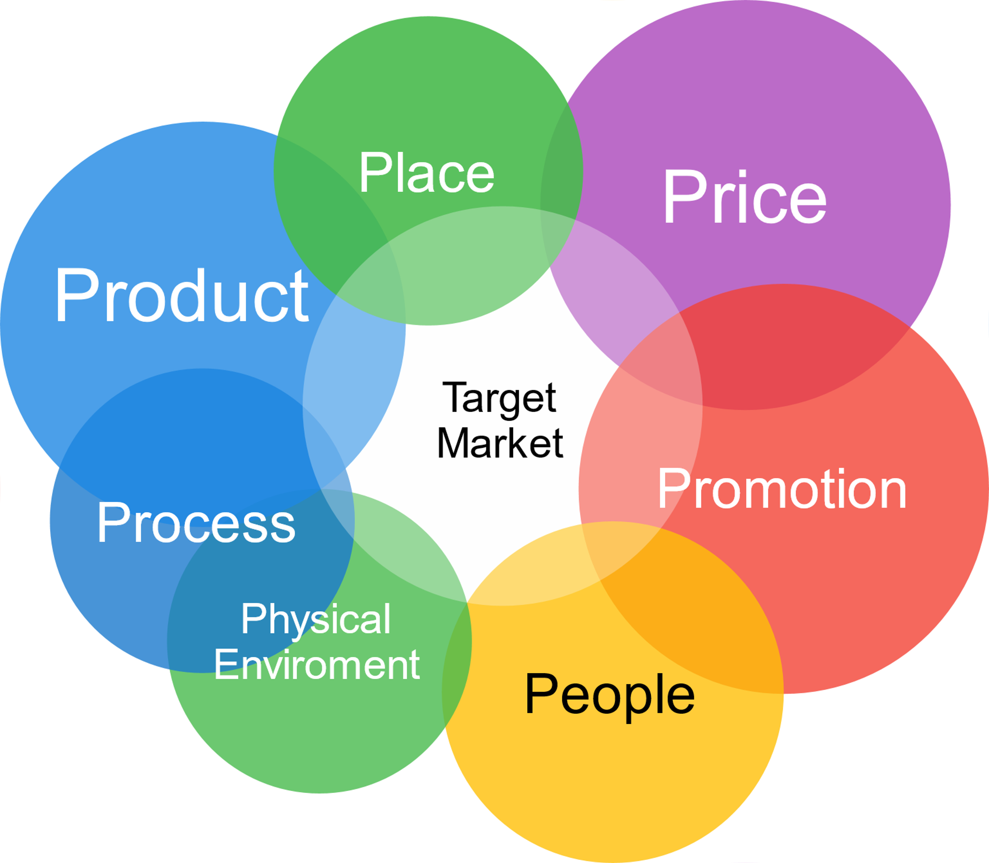
Media Spend Cost Optimization
TEAM:
Aditya Pawar
Himanshu Hegde
Keerthi Krishna
Sri Venkata Namana

Slide 2







Context
Product Distribution
Offline Media Spend
What drives product sales?
Product Pricing, Discounts and Promotions
Competitor Strategies
Online Media Spend
Seasonal Trends

Slide 3


Current State vs Future State
Lack of visibility into the impact of each media channel on product sales.
Diminishing returns (Saturation point vs marketing spend) for each media channel has not been quantified.
No clear insight into Ad-stock effect- Lag between Ad launch and product purchase.
In-efficient allocation of marketing budget.
Understand the effectiveness of different media channels in driving product sales.
Quantify Ad-Stock effect of various media channels.
Assess the Diminishing Returns of each media channel.
Optimize future marketing decisions and quantify its impact.

Slide 4






Stakeholders
CMO and Marketing Teams need MMM to justify marketing spend by showing its impact on sales and to make informed decisions on budget allocation.
Sales Teams benefit from understanding how marketing activities influence customer behavior and sales cycles.
Finance departments are interested in understanding the return on investment (ROI) of marketing activities.
Data Analysts are involved in the technical aspects of MMM, including data collection, model building, and analysis.
​
​
Product Development Teams need information on how marketing for existing products impacts customer preferences and perception.
Brand Managers need to understand how their marketing efforts are contributing to brand awareness, customer acquisition, and sales.

Slide 5




Data
Media Variables: Impressions of and spending on 13 media channels: TV, social media, newspaper ads etc.
Control Variables: Macro Economy CPI, Gas Price, Discount, Holidays, etc.
Product sales and Media spend of a shampoo company, provided by Neustar MarketShare.
Consolidated from sources such as Kantar Media, IRI, ITG, JD Power, and Rentrak.
Four years of weekly data on spending and impressions.
Target Variable: Weekly sales in Dollars.

Slide 6

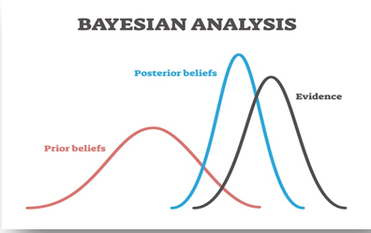


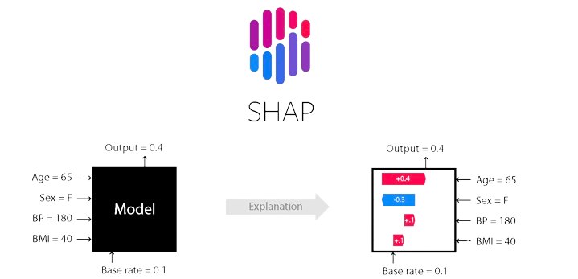
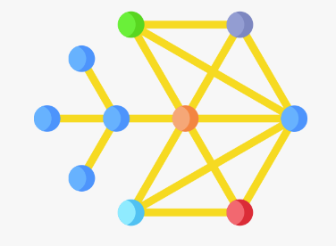

Modelling
Data Preprocessing
Bayesian marketing mix models
Ability to incorporate prior knowledge into the model
Ability to understand correlated features
Exploratory Data Analysis
Feature Engineering
Black-box models with Shapley
Using SHAP(Shapley Additive Explanations) to calculate marginal contribution of features to target in black-box models.
Modelling
Cost Optimization

